Slide 1
The software components of a DBMS, explaining query processor, storage manager, and transaction manager.
y. Naga lasya
192420059
BE bioinformatics
CSA0508

Slide 2
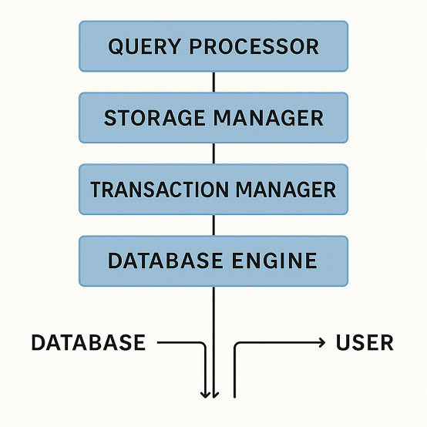
Introduction to DBMS
What is a DBMS?
A Database Management System (DBMS) is software that allows users to create, store, retrieve, update, and manage data efficiently.
Main Software Components
Query Processor
Storage Manager
Transaction Manager

Slide 3
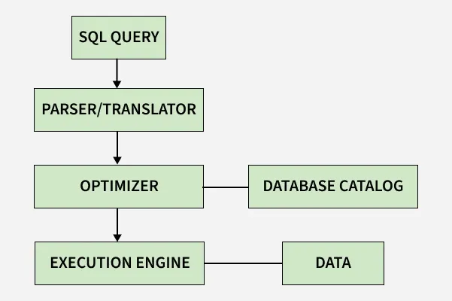
Query Processor
Purpose
Processes SQL queries submitted by users.
Functions
Parses SQL queries.
Checks syntax and validity.
Optimizes query execution.
Executes queries efficiently.
Benefits
Faster query processing.
Efficient use of system resources.

Slide 4
Storage Manager
Purpose
Manages how data is stored and retrieved from the database.
Functions
Stores database files.
Manages indexes and buffers.
Retrieves data efficiently.
Handles disk space allocation.
Benefits
Fast data access.
Efficient storage management.

Slide 5
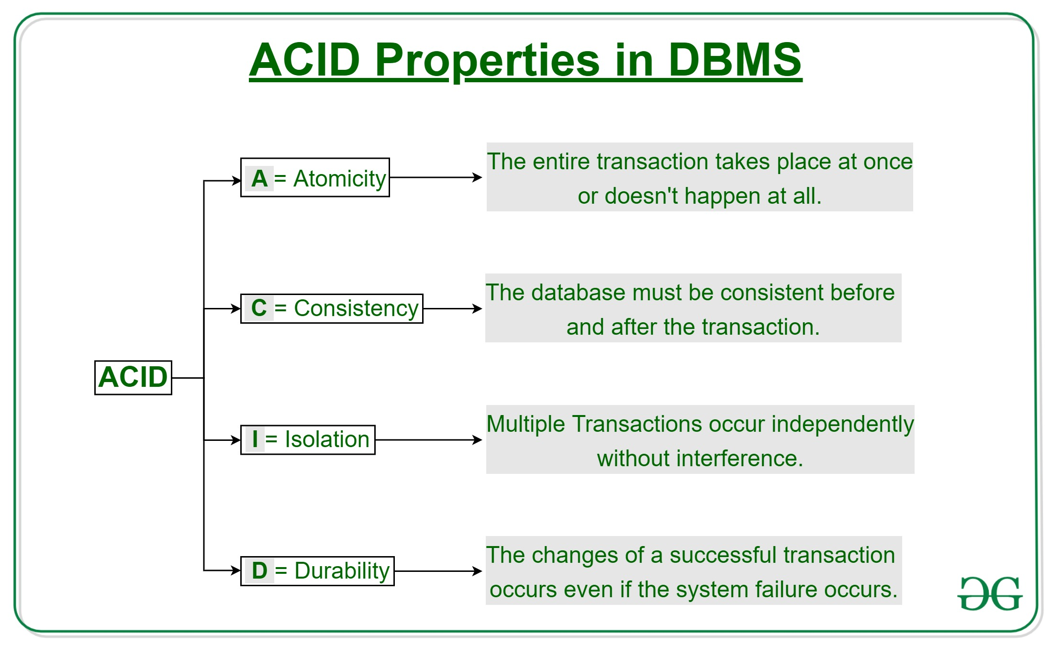
Transaction Manager
Purpose
Ensures safe and reliable execution of database transactions.
Functions
Starts, commits, and rolls back transactions.
Controls concurrent access.
Performs recovery after failures.
Maintains ACID properties:
Atomicity
Consistency
Isolation
Durability
Benefits
Data consistency.
Reliable transaction processing.

Slide 6
Conclusion
Query Processor: Parses, optimizes, and executes SQL queries.
Storage Manager: Manages data storage and retrieval.
Transaction Manager: Ensures reliable and consistent transaction execution.

Slide 7
References
Abraham Silberschatz, Henry F. Korth, and S. Sudarshan, Database System Concepts, 7th Edition, McGraw-Hill Education, 2019.
Raghu Ramakrishnan and Johannes Gehrke, Database Management Systems, 3rd Edition, McGraw-Hill Education, 2003.
Ramez Elmasri and Shamkant B. Navathe, Fundamentals of Database Systems, 7th Edition, Pearson, 2016.
Hector Garcia-Molina, Jeffrey D. Ullman, and Jennifer Widom, Database Systems: The Complete Book, 2nd Edition, Pearson, 2008.
Oracle Corporation, Oracle Database Documentation. https://docs.oracle.com/en/database/

